Slide 1
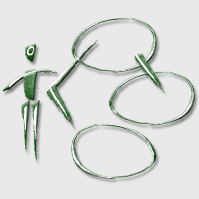
Software Engineering
Requirement Analysis: Quick Recap

Slide 2
Requirements Analysis: Quick Recap
Requirements define the characteristics of the product (be careful with functional requirements and non-functional requirements)
The requirements analysis phase identifies requirements and collect them into a requirement document
UML Approach: Use Case Diagram and Sequence Diagram

Slide 3
UML Diagrams
Static
  Package Diagram
  Use case diagram
  Class diagram and Object diagram
  Component diagram
  Deployment diagram
Dynamic
  Interaction diagrams
    Sequence diagram
    Collaboration diagram
  State diagram
  Activity diagram

Slide 4
UML Diagrams: Main Uses
Static
  Package Diagram: Help you organize your model
  Use case diagram
    Business Modeling: Processes
    Requirements: Functional Requirements
  Class diagram and Object diagram
    Business Modeling: Organization, Entities
    Analysis And Design: Logical Architecture

Slide 5
UML Diagrams: Main Uses
Static
  Component diagram
    Design:
      Physical Architecture
      DB Structure
      Structuring in Files
  Deployment diagram
    Design: Deployment of Executable in Complex Networks

Slide 6
UML Diagrams
Dynamic
  Interaction diagrams
    Business Modeling, Requirements: Interaction User-system
    Analysis And Design: Interaction Among Elements of The System
    Requirements: Functional Requirements (Sequence Diagram)
  State diagram
    Analysis and Design: Specification of the Behaviour of the System
  Activity diagram
    Business Modeling: Workflow
    Analysis and Design: Specification of the Behaviour of the System

Slide 7
UML Diagrams
Static
  Use case diagram
  Class diagram and Object diagram
  Component diagram
  Deployment diagram
Dynamic
  Interaction diagrams
    Sequence diagram
    Collaboration diagram
  State diagram
  Activity diagram

Slide 8
Software Engineering
Use Case Diagram

Slide 9
Use Case Diagram
Use Case
  Set of scenarios describing a coherent unit of functionality as seen by a user of the system.
Actor:
  Set of roles that users can play
Use Case Diagram
  A graph collecting the use cases, the actors taking place in the use cases, and the relationship among use cases and actors.

Slide 10
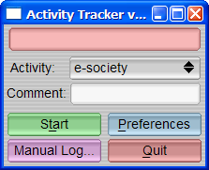
Example: Time Tracker
We have been contacted by a small firm. They want us to build a system for letting employees track how they spend their time when working on a computer. The idea is that of a stop-watch: the users of the system can start and stop counting the time spent on different activities; the system logs such activities and can be used to produce reports.
The system can also be integrated with a billing system. The billing system receives all the information about the time spent by programmers on the different projects and computes the cost of projects. This information is then used to charge clients.

Slide 11
Step 1: Identify Actors
An actor is someone or something that must interact with the System Under Development

Slide 12
Step 1: Time Tracker
We have been contacted by a small software firm.
They want us to build a system for letting employees track how they spend their time when working on a computer. The idea is that of a stop-watch: the users of the system can start and stop counting the time spent on different activities; the system logs such activities and can be used to produce reports by an administrator.
The system can also be integrated with a billing system. The billing system receives all the information about the time spent by programmers on the different projects and computes the cost of projects.

Slide 13
Step 1: Identify Actors
An actor is someone or something that must interact with the System Under Development
User of the system
Billing System
Administrator

Slide 14
Step 2: Identify Use Cases
A use case is a pattern of behavior the system exhibits
Each use case is a sequence of related transactions performed by an actor and the system in a dialogue
Strategies for identifying Use Cases
  Examine Actors to determine their needs
  Find verbs and actions in the description

Slide 15
Step 2: Time Tracker
We have been contacted by a small software firm.
They want us to build a system for letting employees track how they spend their time when working on a computer. The idea is that of a stop-watch: the users of the system can start and stop counting the time spent on different activities; the system logs such activities and can be used to produce reports by an administrator.
The system can also be integrated with a billing system. The billing system receives all the information about the time spent by programmers on the different projects and computes the cost of projects.

Slide 16
Step 2: Identify Use Cases
A use case is a pattern of behavior the system exhibits
Each use case is a sequence of related transactions performed by an actor and the system in a dialogue
Show
Start and stop counting
Compute the cost of projects
Produce reports

Slide 17
Step 3: Use Case Diagram
Use case diagrams are created to visualize the relationships between actors and use cases
Start and stop counting
Produce reports
User of the system
Administrator
Billing System
Show the cost of projects

Slide 18
Use Case Diagram: Elements
Actor is a coherent set of roles that users of an entity can play
  Actors need not be human
  Actors represent roles and not instances (e.g. a person can play different roles when using a system)
Use Case represent a coherent unit of functionality of the system

Slide 19
Software Engineering
Restaurant Management System

Slide 20
Restaurant Management System
Restaurant Management System
We have been asked to build a system to automate the ordering and billing activities of a restaurant. The system is distributed: waiters and waitresses are provided with handheld devices to take orders. The handheld devices communicate orders to the kitchen and to the cashier. The handheld devices receive real-time information about availability of the different items in the menu. Once placed, orders can be changed by the customers, within a time frame from the order (5 minutes) or after the time-out, if the corresponding order has not yet been processed by the Cook.
The system computes bills and is also used to manage reservations of tables. Reservations can either happen by phone or via the internet.

Slide 21
Restaurant Management System
Waiter
Use Handheld Device
Cashier
Cook

Slide 22
Resturant Management System
System = Handheld devices + Computer in the kitchen + Computer at the Cash
Waiter
Take
Order
Reserve a Table
User
Cashier
Manage
Availability of Menù
Compute
Bill
Process Order
Cook

Slide 23
Resturant Management System
System = Computer in the kitchen + Computer at the Cash
Handheld Device
Register
Order
Reserve a Table
User
Cashier
Manage
Availability of Menù
Compute
Bill
Process Order
Cook

Slide 24
Software Engineering
Describe Use Cases

Slide 25
Describe Use Cases
A flow of events document is created for each use cases
  Written from an actor point of view
Details what the system must provide to the actor when the use cases is executed
Typical contents
  How the use case starts and ends
  Normal flow of events
  Alternate flow of events
  Exceptional flow of events

Slide 26
Describe Use Cases
In theory, no particular format for the description of a use case.
In practice, follow a convention.
Title.
Summary.
Description.
Exceptions.
Extension Points.

Slide 27
Describe Use Cases: Example
Title: Buy Ticket
Summary:
This use case describes how tickets can be bought using the reservation system.
Description
Step 1. The User chooses a show and a date. [exception 1]
Step 2. The System shows the seats available.
Step 3. The user provides name and a credit card number [extension 1]
…
Exceptions
[exception 1] If the name of the show and the dates do not correspond, an error message is issue.
…
Extension Points
[extension 1] At step 3, “loyal customers” simply need to enter their PIN.
…

Slide 28
Software Engineering
Making Use Cases more coherent

Slide 29
Some open issues…
Use case coherence
Use case proliferation
As use cases are informal, there is a tendency to forget details when writing use cases.
By describing requirements through scenarios, use cases tend to proliferate (and use case diagrams grow too complex).

Slide 30
Software Engineering
Use Case Diagram: Relationships

Slide 31
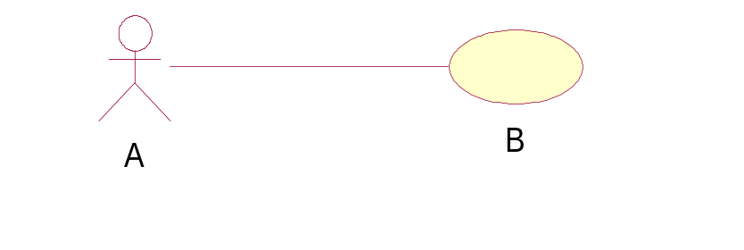
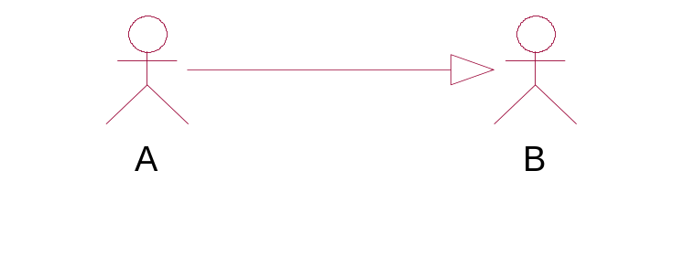
Use Case Diagram: Relationships
Actors Relationships
  Association:
  The participation of an actor in a use case. This is the only relationship between Actors and Use Cases
  Generalization:
  A generalizes B implies that A can perform the use cases of B.

Slide 32
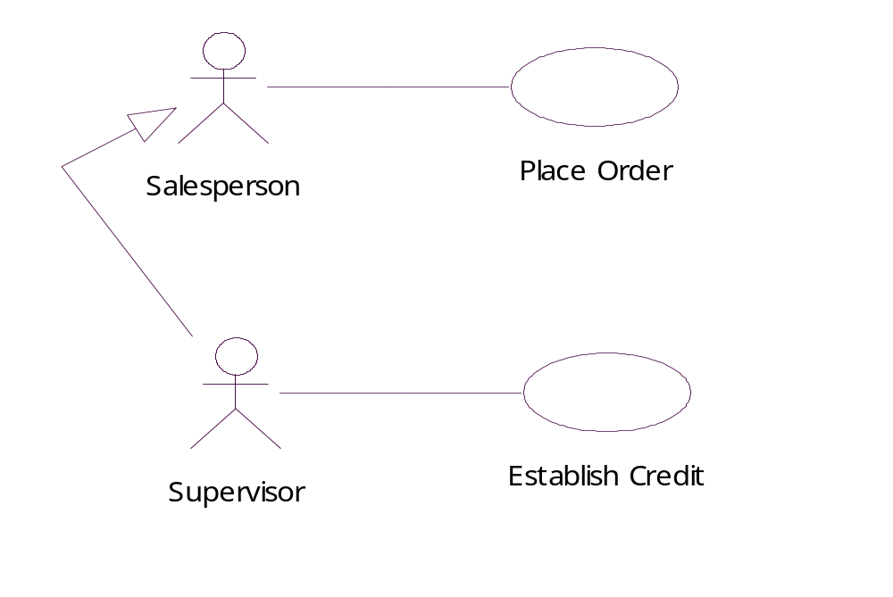
Actors Relationships: Example

Slide 33



Use Case Diagrams: Relationships
Use Case Relationships
Include:
a step of A is the execution of B
Extend:
C does a little more than D does
Generalize:
E does something more specific than F

Slide 34
Use Case Relationships: Example
Supply Customer Data
Order Product
<<include>>
<<include>>
<<include>>
Salesperson
Place Order
Arrange Payment
<<extend>>
Place Order on the Internet
Request Catalog

Slide 35
Hint 1: Actors
Actors are external to the system:
  They help setting the boundaries of the system…
  … as a consequence: the “system” itself can’t be actor!
Actors need not be human:
  Braking System, Hydraulic System, etc are OK!

Slide 36
Hint 2: Actors
Sometimes you need to represent functionality that take place on a regular basis (e.g. backup)
Who is the actor for such a use case?
Solution 1. Who benefits from the execution of the regular action (System Administrator)
Solution 2. What triggers the action, namely: “Time” or “Clock”.
… both 1 and 2 are ok!

Slide 37
Exercise:
Reservation System
We want to build a system for the electronic reservation of seats of a group of movie theatres. The users can either buy tickets for a particular show or buy subscriptions, also by phone. Payments can be performed in cash or by credit card. A supervisor can print the list of seats available for a particular show and see the status of sales performed so far.
A secretary updates the list of shows (by adding/deleting/...)

